Slide 1
Stanford ME469: Midterm Questions and Input File Walk-Through
Stefan P. Domino
Computational Thermal and Fluid Mechanics
Sandia National Laboratories SAND2018-4536 PE

Slide 2
Questions and Input File Walk Through
Typical Questions Fielded
EBVC Input
CVFEM Input

Slide 3
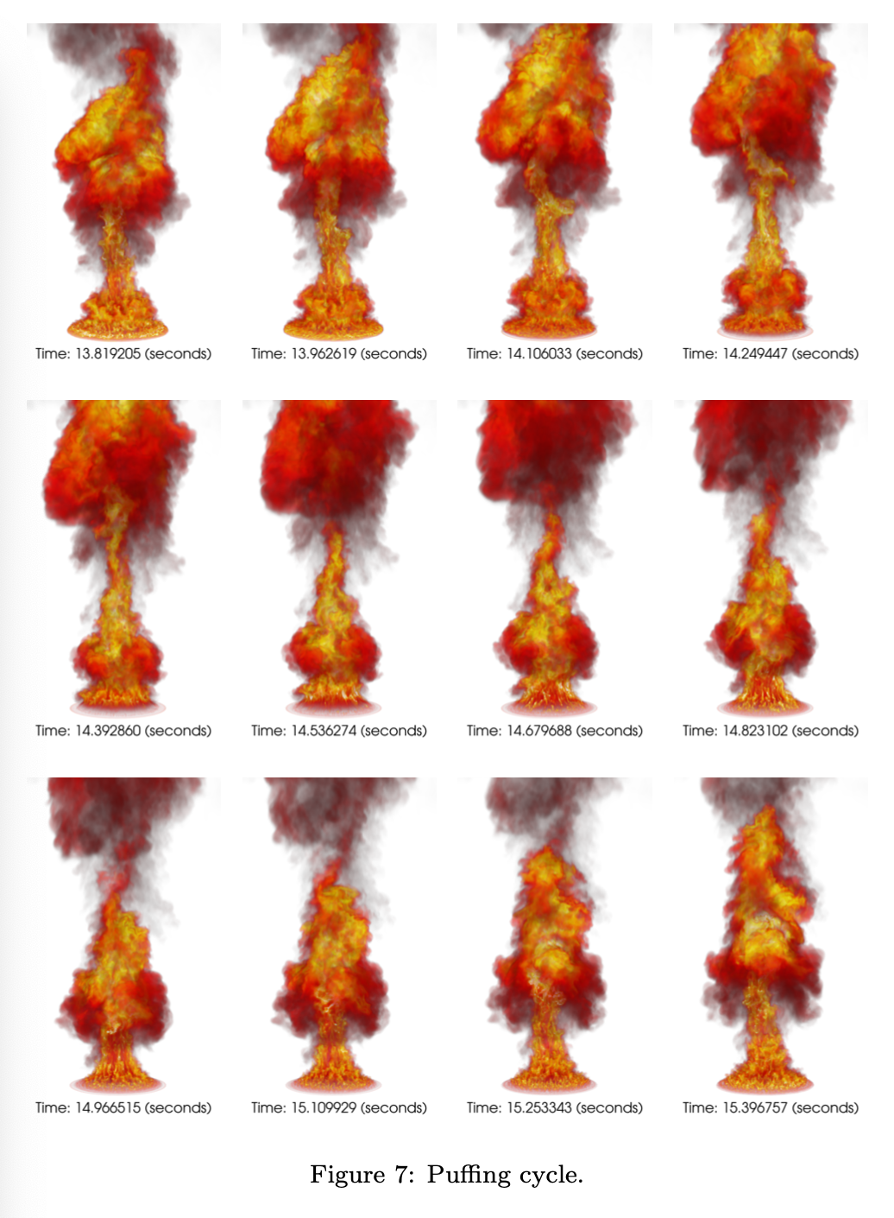
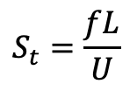
Q1: If the Strouhal number is the QoI, how do I compute that?
$$S_{t}=\frac{fL}{U}$$
The Strouhal number is defined as, where f is a frequency (Hz), L a characteristic length scale, and U a reference velocity
Probing a particular location and/or variable over time will produce a time signal, for example, in this example, we see a turbulent reacting flow example: QoI is the puffing frequency
Computing a FFT of the signal should yield a characteristic peak
Domino et al., “Validation of an unsteady famelet and large-eddy simulation-based model suite for a large-scale JP-8 pool fire”, Submitted, Combust. Flame, 2021

Slide 4
Q2: How do I interpret the timing information?
Recall, that we are running a parallel simulation. Specifically, each processor has been assigned a particular “job”
Efficiency of parallel scaling requires good load-balancing
The code provides min/max/avg/sum timings for key algorithmic paths
It may be interesting for you to look at the timings between CVFEM and EBVC for select operations…
Timing for Eq: MomentumEQS
init -- avg: 5.45713 min: 5.44055 max: 5.47628
assemble -- avg: 16.2114 min: 16.1217 max: 16.2904
load_complete -- avg: 0.160093 min: 0.0851765 max: 0.265414
solve -- avg: 33.4897 min: 33.4544 max: 33.5551
precond setup -- avg: 0.335892 min: 0.272227 max: 0.371449
misc -- avg: 6.38337 min: 6.19594 max: 7.42213
linear iterations -- avg: 18.65 min: 8 max: 38
Min No-output time 136.9932 sec
Avg No-output time 137.0108 sec
Max No-output time 137.0243 sec

Slide 5
Q3: What is a nonlinear residual?
In this vortex street case, we are solving for velocity (momentum), pressure (continuity), and passive scalar (mixture fraction)
Although the mixture fraction equation is decoupled, the continuity and momentum equation are coupled. As such, the level of convergence for this system is captured in the nonlinear residual.
In Nalu, we scale the nonlinear residual by the value obtained at the first time step
{
do while (!converged) {
}
For a given
time step:

Slide 6
Q4: What is Peclet blending again?
A classic advection stabilization approach is to use a Galerkin (or central) operator blended with upwind.
Recall, that the Peclet number for an advection/diffusion equation speaks to the ratio of advective transport rate to diffusive transport rate.
In our early stability analysis, recall that monotonicity was only captured when the cell Peclet number was less that 2
The default Nalu implementation is to use a steep blending function such that for cell Peclet numbers greater than 2, upwind is predominately used.
- peclet_function_form:
velocity: tanh
- peclet_function_tanh_transition:
velocity: 2.0
- peclet_function_tanh_width:
velocity: 4.0

Slide 7
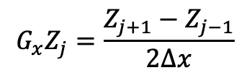
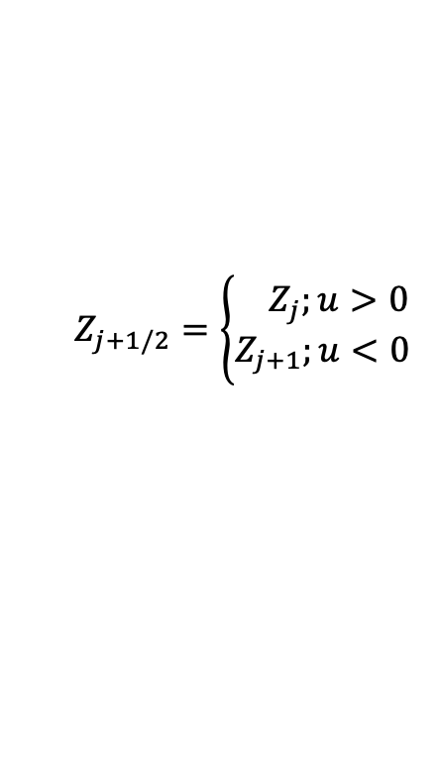
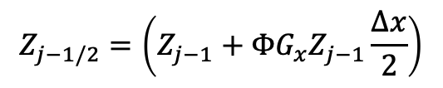
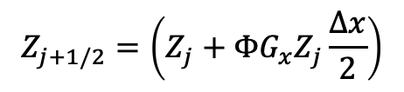
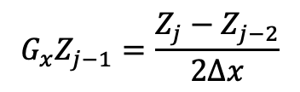
Q5: What is a limiter? Did I miss that?
We only briefly discussed this point, however, we will recall that for an unstructured method, we are generally limited by the amount of data that we can extract for a particular mesh object that we are iterating, e.g., node, edge, face, element
The use of a projected nodal gradient allows for us to extrapolate a higher-order stencil; however, this extrapolation can admit a non-monotonic value within the mesh object
j-1
Z_{j-1/2}
j
Z_{j+1/2}
j+1
$$Z_{j+1/2}=\left\{\begin{aligned}{ Z}_{j};u>0 \\ Z_{j+1};u<0\end{aligned}\right.$$
$$G_{x}Z_{j}=\frac{Z_{j+1}−Z_{j−1}}{2∆x}$$
$$G_{x}Z_{j−1}=\frac{Z_{j}−Z_{j−2}}{2∆x}$$
for u>0
$$Z_{j+1/2}=\left(Z_{j}+{ΦG}_{x}Z_{j}\frac{∆x}{2}\right)$$
$$Z_{j−1/2}=\left(Z_{j−1}+{ΦG}_{x}Z_{j−1}\frac{∆x}{2}\right)$$
- limiter:
velocity: yes
mixture_fraction: no

Slide 8
Q6: Why not a FEM case?
Yes, Nalu supports FEM, however, only with limited element topology support.
Currently, we only support Hex8, Tet4, and (limited) Tri3
Sadly, the street mesh is a Quad4/Tri3 combination
If you are interested in implementing a complete Quad4 and Tri3 element type (or even Quad9, Tri6) within this class, let me know… This could serve an interesting final project☺

Slide 9
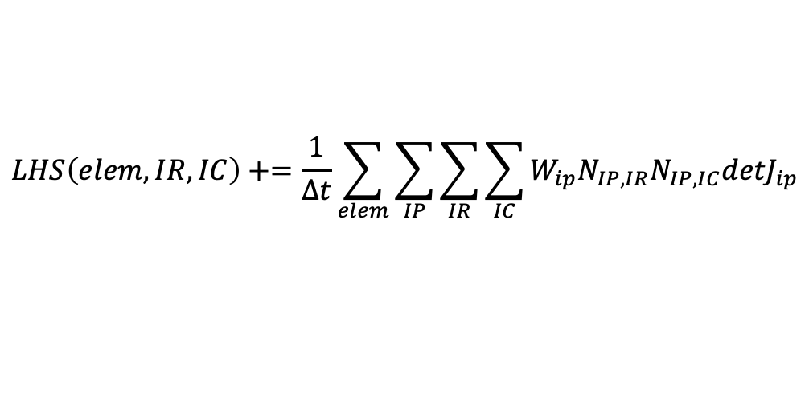
Q7: What is this lumped vs non-lumped option for the time derivative?
﻿ - element_source_terms:
momentum: [momentum_time_derivative]
j-1
Z_{j-1/2}
j
Z_{j+1/2}
j+1
Recall that the EBVC scheme computes time and source terms at the nodes . In the above example, the “lumped mass matrix” stencil is:
h/Δt[0 1 0] (Z_{j-1}, Z_{j}, Z_{j+1})^{T}
For the CVFEM scheme, evaluation of the time/source term at the volume quadrature points . In the above example, this results in a ”consistent mass matrix”:
h/(8Δt)[1 6 1] (Z_{j-1}, Z_{j}, Z_{j+1})^{T}
For the FEM scheme, evaluation of the time/source term at the volume quadrature points . In the above example, this results in a ”consistent mass matrix”:
h/(6Δt)[1 4 1] (Z_{j-1}, Z_{j}, Z_{j+1})^{T}
h
“row sum lump” A_{ii} += A_{ij}, j!=i
CMM reduces numerical dispersion at the cost of reduced diagonal dominance; FEM is symmetric by construct
$$LHS\left(elem,IR,IC\right)+=\frac{1}{Δt}\sum_{elem}{\sum_{IP}{\sum_{IR}{\sum_{IC}{W_{ip}N_{IP,IR}N_{IP,IC}{detJ}_{ip}}}}}$$
(see femMM.C under Canvas Pages)

Slide 10
Q8…QN?
Discussion…. Before CVFEM and EBVC input walk through…
https://github.com/NaluCFD/Nalu/tree/master/examples/street

